Slide 1

GEOG 178/258
Week 6:
UML, Poisson Distributions & Midterm Prep
mike johnson

Slide 2
PART 1: UML

Slide 3
Unified Modeling Language
UML is a standardized modeling language consisting of diagrams
Developed to help system and software developers specify, visualize, document and construct software systems.
UML is another way of modeling an abstraction of reality
Week
6
UML

Slide 4
UML Class
Week
6
UML
Classes are represented as rectangles with stacked compartments:
The top compartment shows the class name (Flight)
The middle: the class attributes
The last: the class operations (aka methods)
Think about how this already mirrors our structure of (Attributes, Constructors, Getters& Setters, Methods)

Slide 5
UML Class
Week
6
UML
Attribute lines are optional but if included are written in the following structure:
Name : attribute type
In many “everyday” class diagrams, the attribute types usually show units that make sense to readers (i.e., minutes, dollars, etc.). However, a class diagram that will be used to generate code needs classes whose attribute types are limited to the types provided by the programming language, or types included in the model that will also be implemented in the system.
Often default values will be provided as well:
MyBank: double = 0

Slide 6
UML Class
Week
6
UML
Operations are documented is a list format in the following notation:
Name(parameter list) : type of value returned
(think to the signature of your methods like isInside!)
When parameters are needed the name and type should be explicitly provided:
isInside (P1 : Point, P2: Point) : Boolean

Slide 7
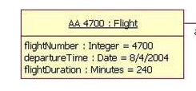
UML Class
In important (or specific cases) UML can be used to diagram a particular instance of a class
Week
6
UML

Slide 8
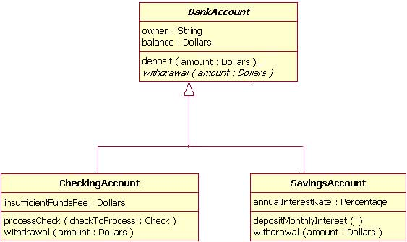
UML Inheritance
REVIEW: inheritance refers to the ability of one class (child class) to inherit the identical functionality of another class (super class), and then add new functionality of its own.
Week
6
UML

Slide 9
Symbol Descriptions
Week
6
UML
For more look here

Slide 10
UML Class Generic Example
public class Example {
private int x;
protected int y;
public int z;
public Example() { ... }
public String toString() { ... }
private void foo(int x) { ... }
protected int bar(int y, int z) { ... }
}
Week
6
UML

Slide 11
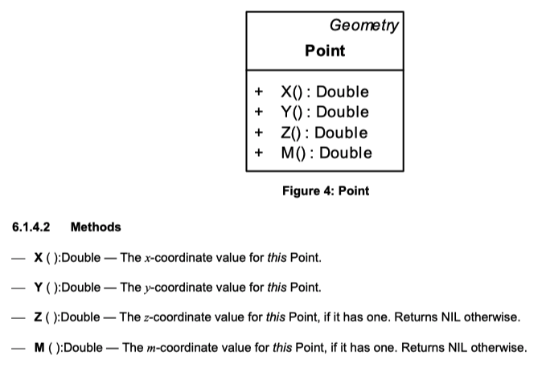
OGC Point
Week
6
Private variables
UML

Slide 12
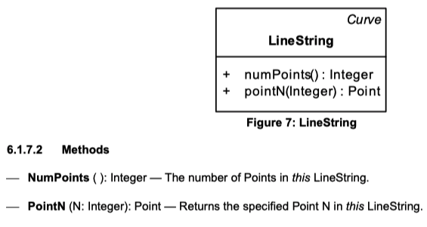
OGC
Week
6
UML

Slide 13
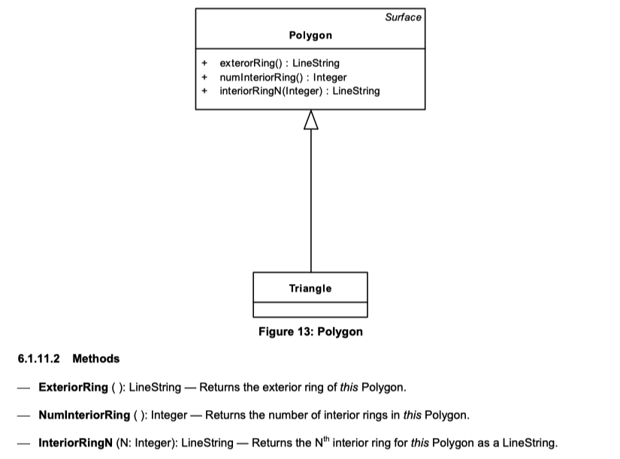
OGC Polygon
Week
6
UML

Slide 14
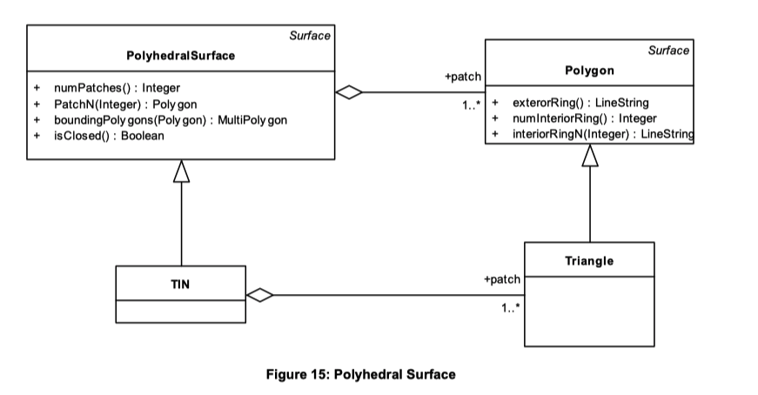
OGC. PolyhedralSurface
Week
6
UML

Slide 15
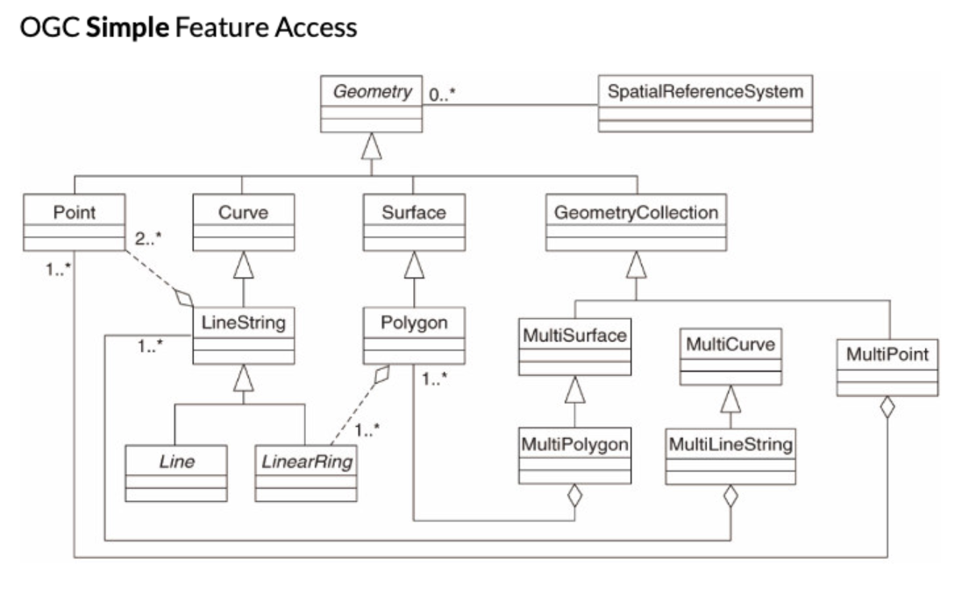
The `Big 7` Geometries
OGC Simple Features
Week
6
UML

Slide 16
Real Life UML Data Modeling
WaterML (click me)
Week
6
UML

Slide 17
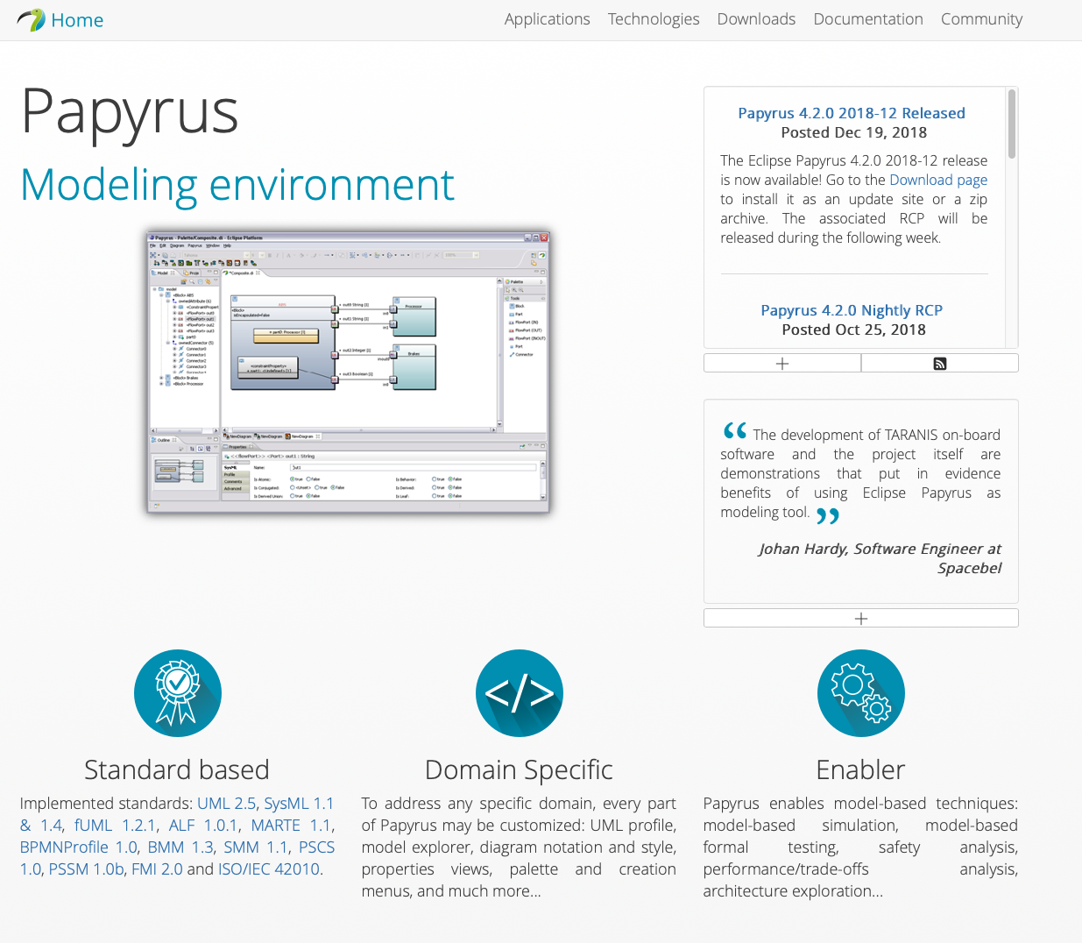
UML in Eclipse
Week
6
UML
https://www.eclipse.org/papyrus/

Slide 18
PART 2: Poisson Distributions

Slide 19
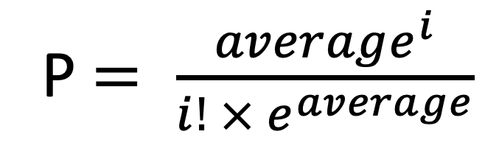
Poisson Distribution
The Poisson Distribution is a discrete probability distribution that expresses the probability that a given number of events, occurring in a fixed interval of time or space with a known constant rate and independently of the time since the last event.
Week
6
Poisson
P $= \frac{{average}^{i}}{i! × e^{average}}$

Slide 20
Story
Number of Campers | Number of Plots
1 | 278
2 | 92
3 | 25
4 | 4
5 | 0
6 | 0
7 | 1
5
Week
6
Week
Poisson
Our goal:
What is the Poisson Distribution of these campers ?
Can campers/plots able to be described by such a discrete distribution?

Slide 21
Campers, Plots and Poisson
EXAMPLE # 1

Slide 22
Getting Poisson to Github
EXAMPLE # 2

Slide 23
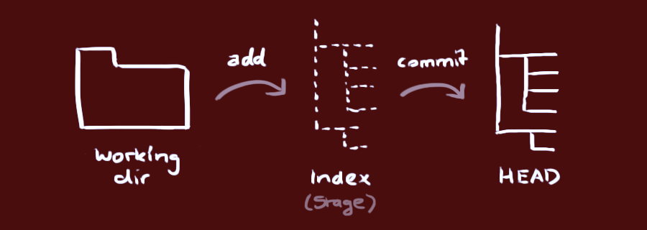
Version Control
Week
6
Github

Slide 24
Github Workflows
Create a new git repository: git init
Checkout an existing Repo: git clone <path>
Connecting to remote repo: git remote add origin <server path>
Adding files: git add <filename>
Adding all files: git add *
Committing to HEAD: git commit –m message
Pull files: git pull origin master *master can be subbed for any branch
Pull files and realign: git pull –rebase
Push files: git push origin master *master can be subbed for any branch
Week
6
Cheat sheet

Slide 25
Branching
Week
6
Github

Slide 26
Branching Workflow
Create a new branch called “new_feature”:
git checkout –b new_feature
Switch back to master:
git checkout master
Switch back to branch
git checkout new_feature
Combine branches (from master)
git checkout master *be sure your in master
git merge new_feature
** Sometimes conflicts will occur between branches that make merging impossible.
You have to fix these manually and add them back in via git add <file>
*** If you really mess up a file you can get the original back:
git checkout <filename>
Week
6
Cheat sheet

Slide 27
PART 3: HW and MT Hints

Slide 28
Homework Hints!
Interfaces
Geometry {getLength, getArea}
BoundingArea {isInside}[G]
Polypoints{getPoints, setPoints, getPointCount} [G]
Needed Classes:
BoundingBox (BA)
Circle (G)
Point (G)
PointBuffer (BA)
Polygon (PP)
Polyline (PP)
Rectangle (G)
Square (G)
Test (NA)
() implements
[] extends
Week
6
Homework Hints

Slide 29
Midterm Examples
Week
6
MT
Check out the class site for an example set of MT questions

